Slide 1
High-throughput experiments elucidate the impact of multicomponent interactions on solute transport in complex feed streams
Laurianne Estrada, Jonathan A. Ouimet, William Phillip

Slide 2
Multicomponent Experiments

Slide 4

$$χ=−44$$

Slide 5

$$χ=0$$

Slide 6

$$χ=−144$$

Slide 7
Fixed membrane charge = -44 mM:
When this value is set to 0 mM, the Dm values collapse (as they do with Ds).
However, when this value is set one order of magnitude larger (-144mM), Dm becomes more scattered and chaotic.
Furthermore, a few of the main Dm terms become negative.

Slide 8
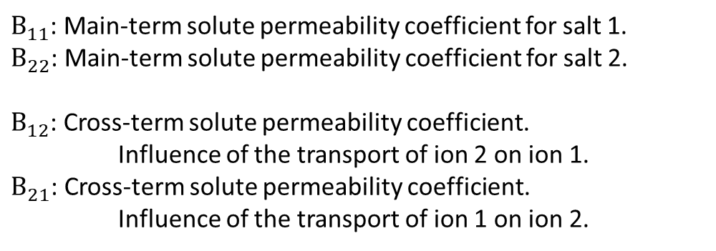
Nomenclature
$B_{11}$: Main-term solute permeability coefficient for salt 1.
$B_{22}$: Main-term solute permeability coefficient for salt 2.
$B_{12}$: Cross-term solute permeability coefficient.
Influence of the transport of ion 2 on ion 1.
$B_{21}$: Cross-term solute permeability coefficient.
Influence of the transport of ion 1 on ion 2.

Slide 9
Solute Permeability Coefficients

Slide 10
Solute Permeability Coefficients

Slide 11
Solute Permeability Coefficients/Driving Force

Slide 12
Solute Permeability Coefficients/Driving Force

Slide 13
Solute Permeability Coefficients/Driving Force

Slide 14
Solute Permeability Coefficients/Solute Flux

Slide 15
Solute Permeability Coefficients/Solute Flux

Slide 16
Solute Permeability Coefficients/Solute Flux

Slide 17
Solute Flux

Slide 18
Solute Flux

Slide 19
Solute Flux

Slide 20
Driving Force

Slide 21
Driving Force

Slide 22
Driving Force

Slide 23
Solute Flux/Driving Force

Slide 24
Solute Flux/Driving Force

Slide 25
Solute Flux/Driving Force

Slide 26
Partition Coefficients

Slide 27
Partition Coefficients

Slide 28
Partition Coefficients

